Slide 1
Before we start…
Consider the “Coding question for the start of Lecture 6”, which you will find on Moodle…
We will discuss this question at the start of the lecture.

Slide 2
CASA0011: Agent-Based Modelling
Dr Sarah WISE
Dr Thomas OLÉRON EVANS
s.wise@ucl.ac.uk
thomas.evans.11@ucl.ac.uk
Moodle password: ABM20
Centre for Advanced
Spatial Analysis,
90 Tottenham Court Road

Slide 3
LECTURE 6 Modelling Competitive Agents

Slide 4
OBJECTIVES 1. Understand the basics of Game Theory and how it can be used to model competitive interactions. 2. Gain experience of programming agents with memory in NetLogo.

Slide 5
Course Objectives
You should...
1. understand the principles of
agent-based modelling (ABM).
2. be able to describe the type and range of systems to which ABM can be profitably and appropriately applied.
3. be able to conceptualise and model
urban systems with complex dynamics.
4. show evidence of being able to translate your
understanding into the practical methodology of modelling

Slide 6
The ABM Course
Week 1: Introduction to ABMs
Week 2: Cellular Automata
Week 3: ABM Methodology
Week 4: Agent Behaviours
Week 5: ABMs as Research Tools
READING WEEK
Week 6: Modelling Competitive Agents
Week 7: Presenting Results
Week 8: Forecasting & Prediction
Week 9: Verification and Validation of ABMs
Week 10: Applications of Agent Based Modelling

Slide 7
Competitive Agents Principles of Game Theory

Slide 8
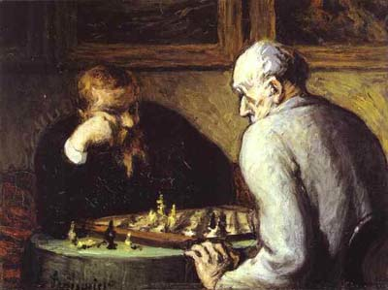
What is a Game?
Any situation in which different players compete to maximise a payoff.
Players may be people, businesses, animals, computers, etc.
Payoff could be profit, reproductive fitness, utility, etc.
The payoff to each player depends on decisions that they all make.

Slide 9
Example
Your Decision
D
No D
M
No M
M
No M
Opponents’Decision
0.8
0.2
0.01
0.5
https://commons.wikimedia.org/wiki/File:Messi_vs_Atlante.JPG

Slide 10
Matrix Games
Opponents
(Column Player)
M
No M
D
(0.8, 0.2)
(0.2, 0.8)
You
(Row Player)
No D
(0.01,0.99)
(0.5, 0.5)

Slide 11
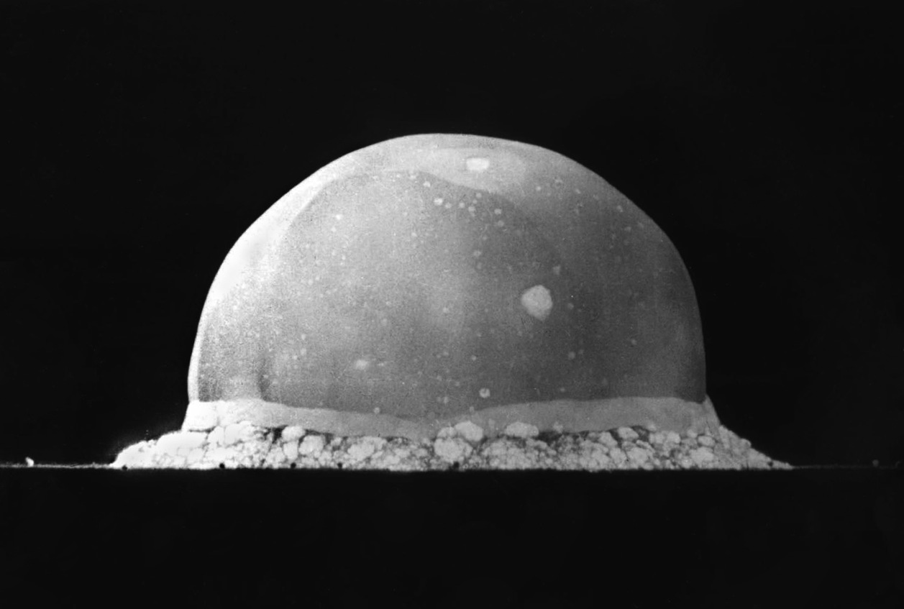
MAD

Slide 12
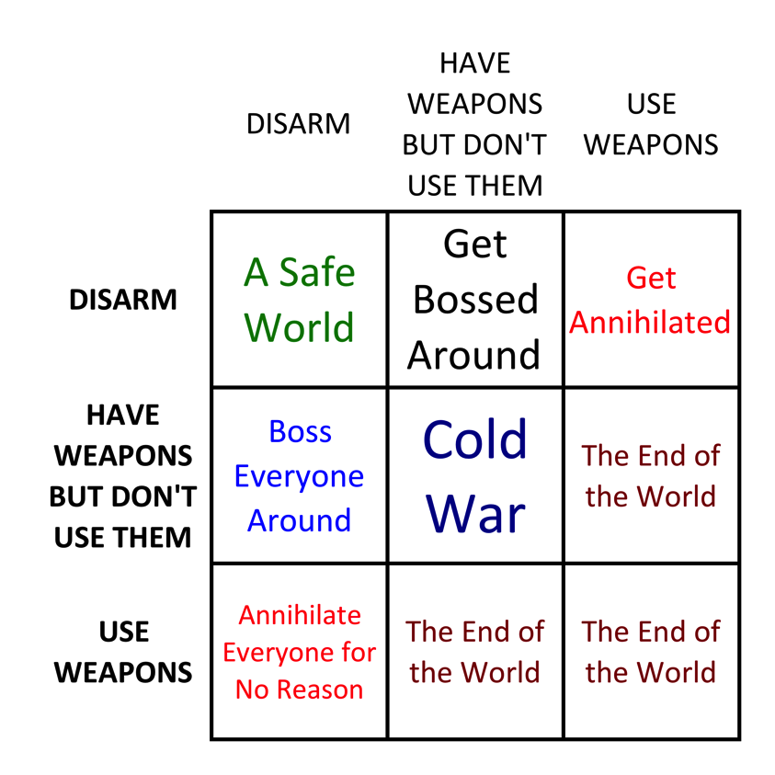
MAD

Slide 13
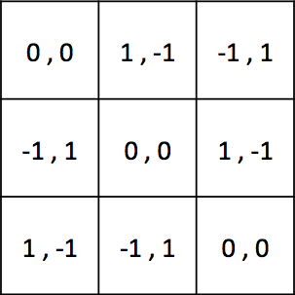
Matrix Games
A
B
C
A
B
C

Slide 14
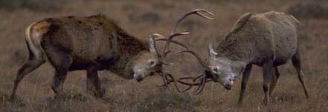
Why do some animals expend
huge amounts of energy to grow
ostentatious weapons that are
almost never used?

Slide 15
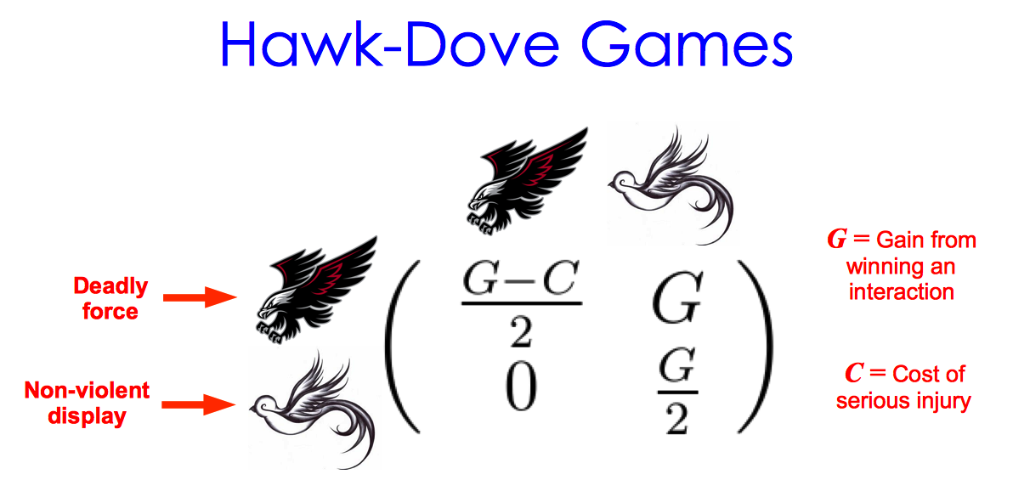

Slide 16
(100)
–50
100
0
50
(200)

Slide 17


The Prisoner’s Dilemma
Image: PD

Slide 18
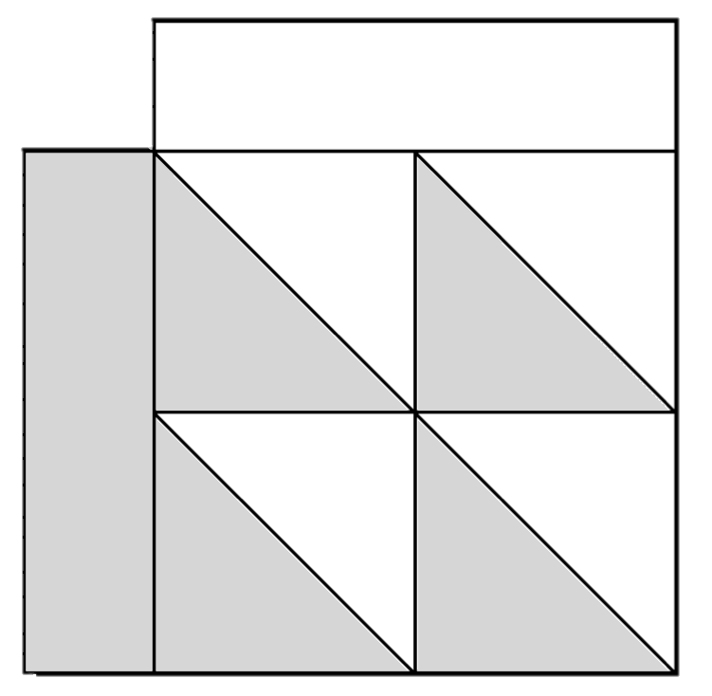
C
D
6
10
C
6
0
0
2
D
10
2

Slide 19
Clean
Dope
Fair & Honest Contest
Win
Clean
Fair & Honest Contest
Lose
Fair contest
Lose
Dope
Win
Fair contest

Slide 20
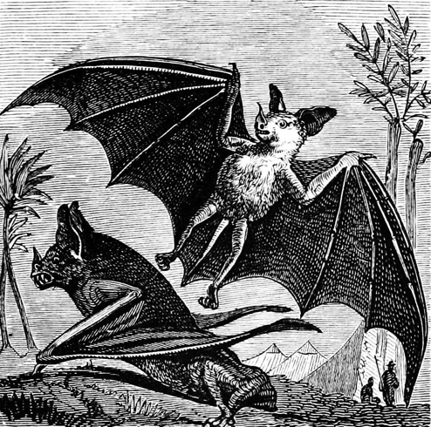
Don’t Share
Share
Good chance of survival
Almost certain to survive
Share
Good chance
of survival
No
chance
of survival
No chance of survival
Poor chance of survival
Don’t Share
Almost certain
to survive
Poor
chance
of survival

Slide 21
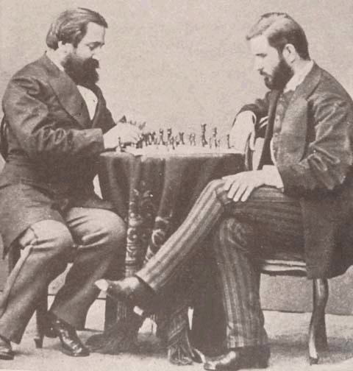
What is the best strategy?
Image: PD

Slide 22
C
D
Against...
ALWAYS C
ALWAYS D
ALTERNATE CD
6
10
C
6
0
0
2
D
10
2

Slide 23
Why do people
cooperate?

Slide 24

Grim Trigger
What is the best strategy to
use against Grim Trigger?
Image: CC (Hélène Rival) http://commons.wikimedia.org/wiki/File:Pistolet_incruste.jpg

Slide 25


The Axelrod Tournaments
Image: http://www.angleseycomputersolutions.com

Slide 26
The Axelrod Tournaments
Tournament 1
Winner:
Tournament 2
Winner:

Slide 27


Tit For Tat
??? :
TFT :

Slide 28
Why is TFT so effective?
??? :
TFT :
1) NICE
2) UNEXPLOITABLE
3) SIMPLE
4) FORGIVING

Slide 29
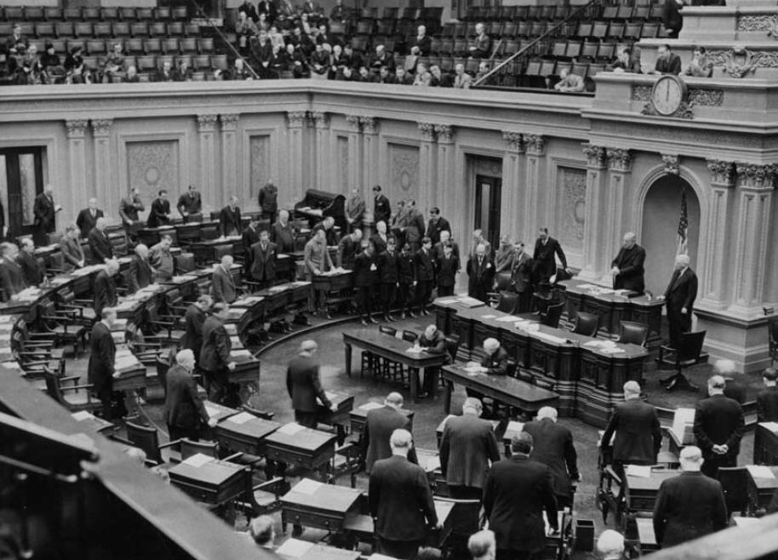
What is the relevance?
Image: PD

Slide 30
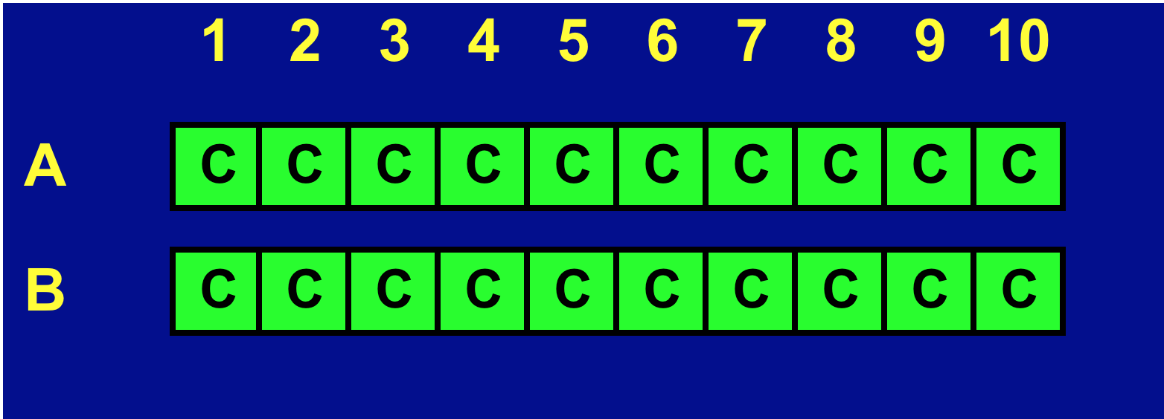
Problem Solved?

Slide 31
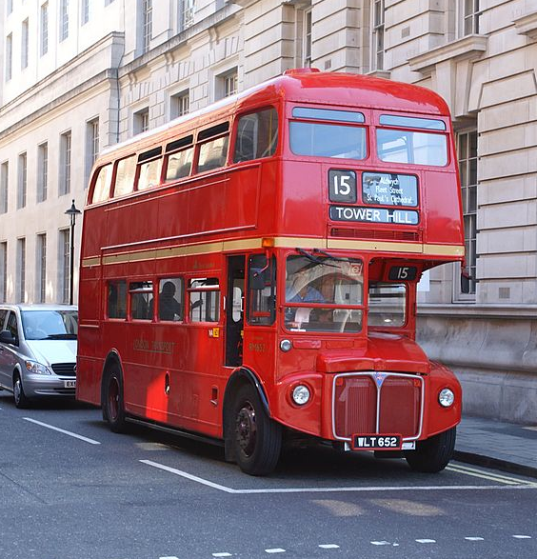
What keeps people cooperating?
Would you rather
have £100 today...
… or £1 in a
year's time?
Image: CC (Hideyuki KAMON) http://commons.wikimedia.org/wiki/File:London_bus_in_Whitehall,_5_August_2007.jpg

Slide 32
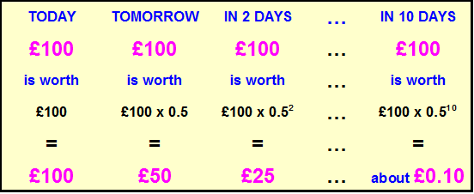
Future Utility
Suppose the discount parameter is w = 0.5 :
In this example, the total utility over 10 days is:
100.00 + 50.00 + 25.00 + … + 0.10 ≈ 199.80

Slide 33

Discount Parameter
1 p p² p³ p⁴ p⁵
1 1/2 1/4 1/8 1/16 1/32

Slide 34
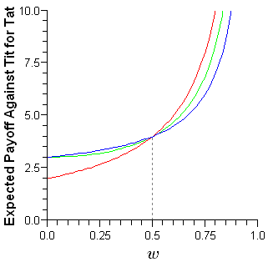
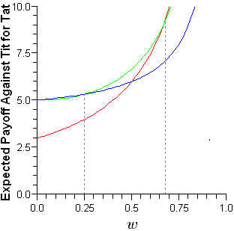
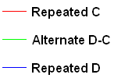
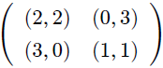
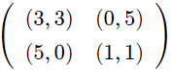
Best Response to TFT
For
For
If w is large enough then the
best response to TFT is “Always C”

Slide 35
How can cooperation be promoted...?
Axelrod’s 5 Rules
Increase the likelihood of continued interactions;
Change the payoffs;
Teach altruism;
Teach reciprocity;
Make participants more recognisable to one another.

Slide 36

http://ncase.me/trust/

Slide 37
How might strategies change
over time across a population?

Slide 38
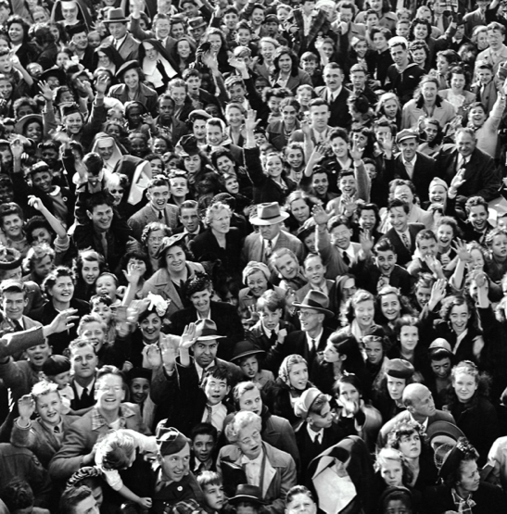
Game Theory Population Models
Assume…
Large population of individuals.
Individuals interact randomly in pairs.
Interactions take the form of a two-player game (e.g. the Prisoner’s Dilemma).
How will the strategies used by the population change as time passes?
Large Population of Players

Slide 39
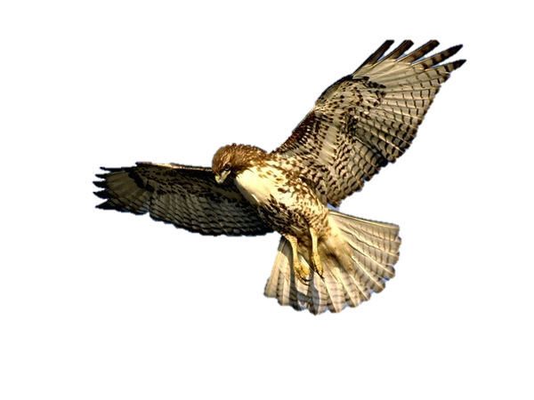

Hawks and Doves
– 4
0
– 4
2
2
1
0
1
https://www.youtube.com/watch?v=RAKjII7xCdk

Slide 40
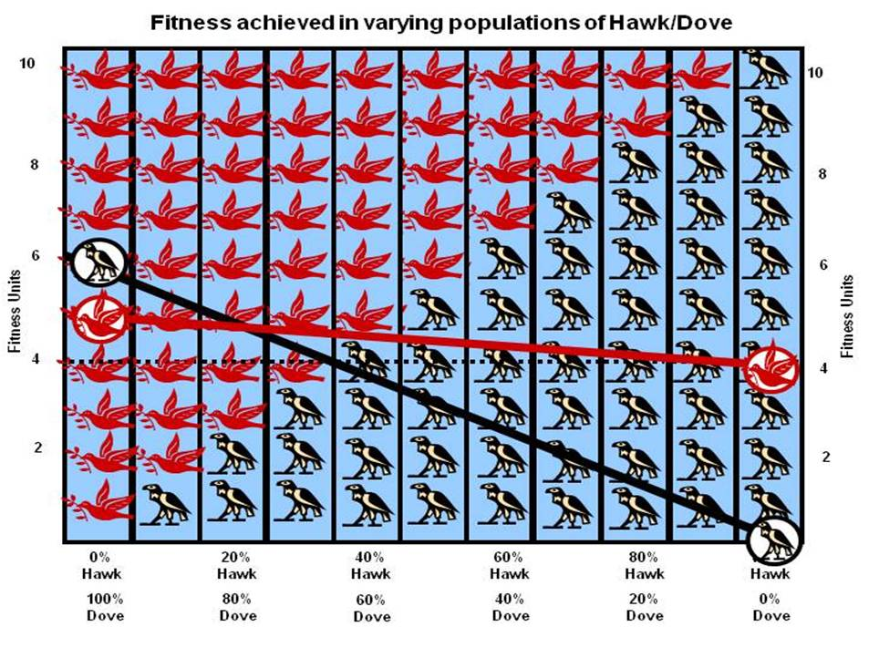

Slide 41
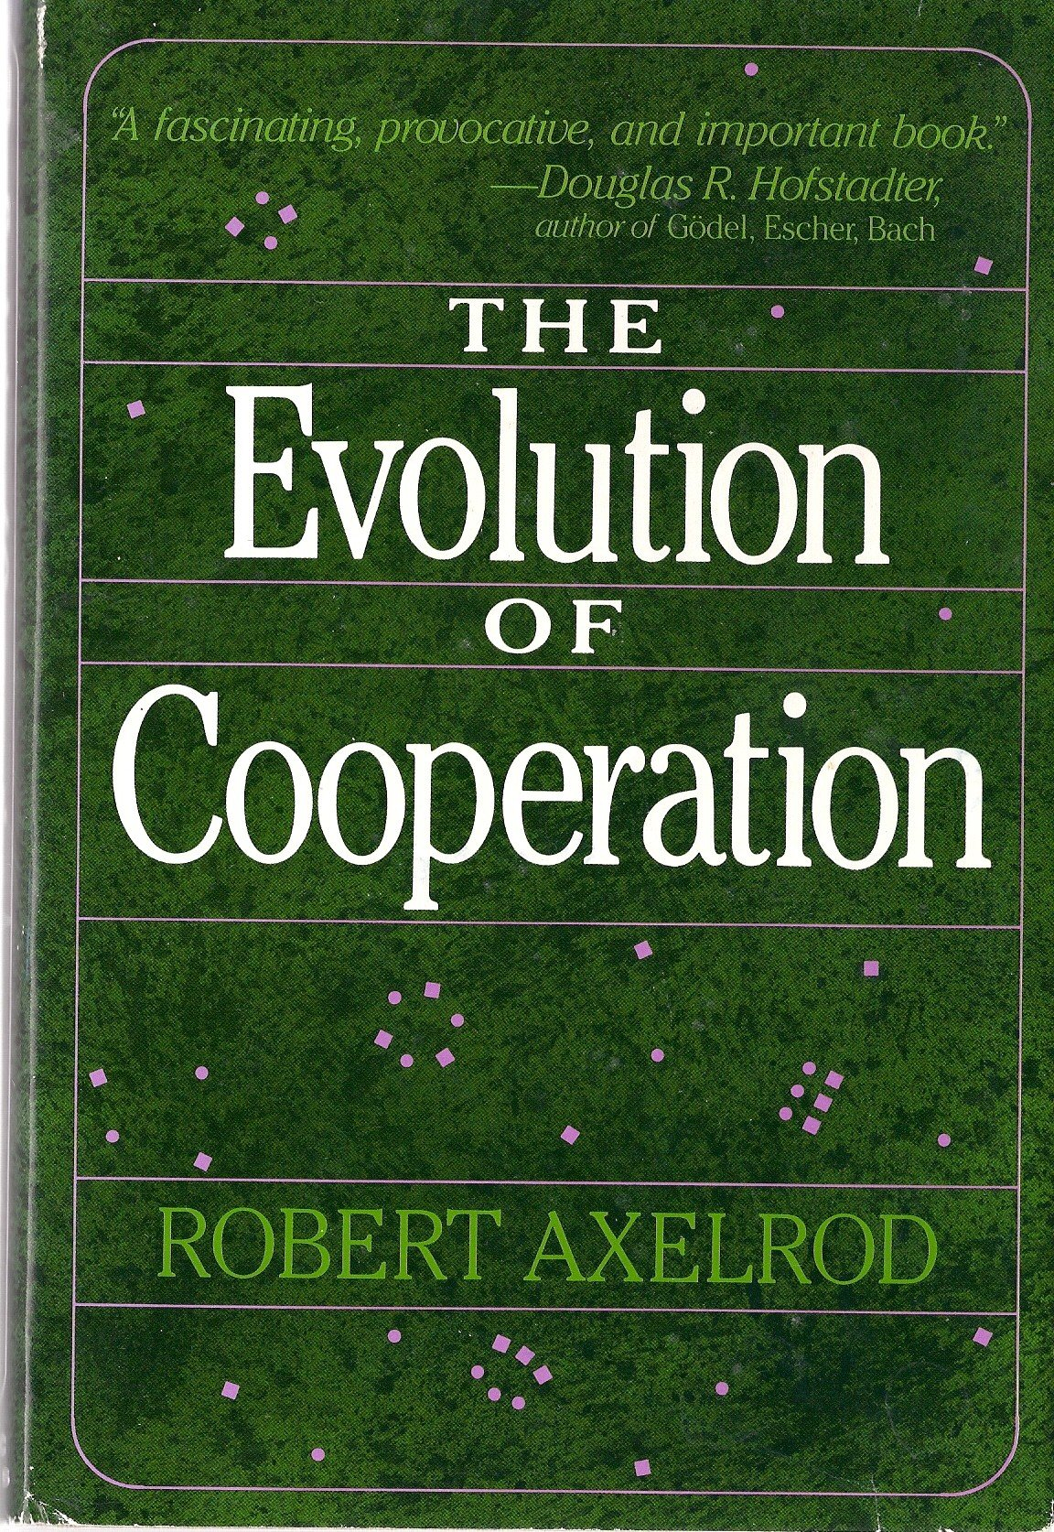

Suggested Reading

Slide 42
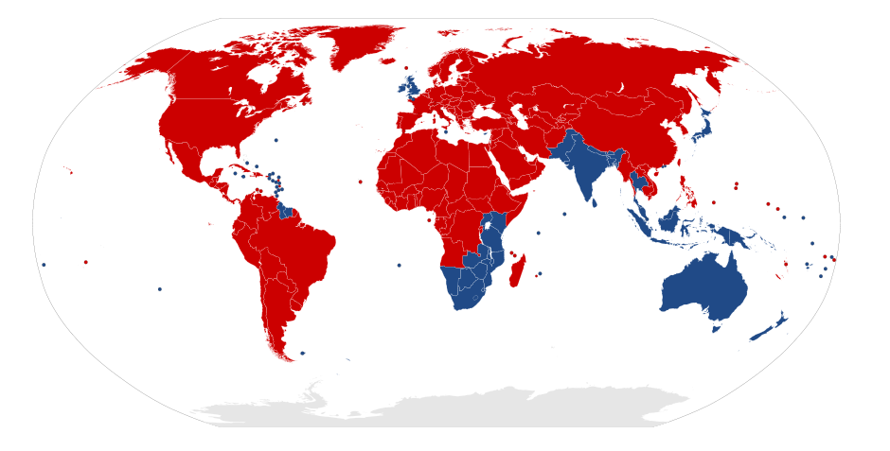
What does this map show...?

Slide 43
OBJECTIVES 1. Understand the basics of Game Theory and how it can be used to model competitive interactions. 2. Gain experience of programming agents with memory in NetLogo.

